Slide 1
Getting back up when you’ve been knocked down
How We Turned Our Company’s Worst Outage into a Powerful Learning Opportunity
Erica Morrison
Executive Director, Software Engineering
@ericarmorrison

Slide 2
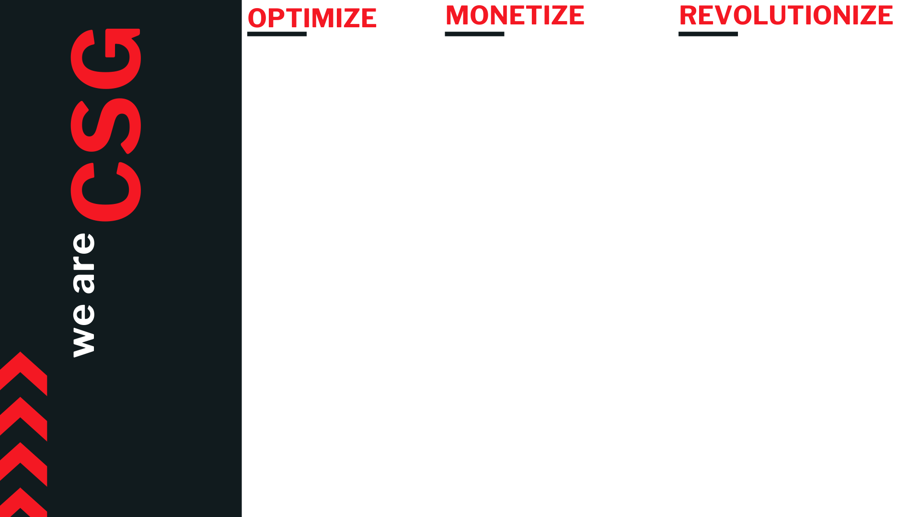




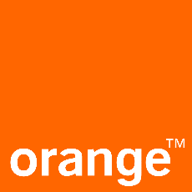





65 MILLION SUBSCRIBERS
8 BILLION TRANS/M
100+ GLOBAL DEVOPS TEAMS
24 COUNTRIES
50+ APPS
20+ TECHSTACKS
REVENUE MANAGEMENT
2.0
DIGITAL MONETIZATION
CUSTOMER COMMUNICATION MANAGEMENT
PAYMENT
GATEWAY SERVICES
Notes:
Before we being, I’d like to talk a bit more about CSG. We are the largest SaaS-based customer care and biling company in North America.. 61M subs across major operators. 40 dev teams & 1000 prac. ACP crosses 20 tech from ASM to JS.
Same challenges as others: TTM, quality of sw and operations.

Slide 3
OUR DEVOPS JOURNEY
2015
Reducing batch sizes, applying agile and lean
2016
Transforming organizational structures
2017
Spreading culture, investing in engineering, shifting ops left
2018
Adding more automation, shifting security left!
2019
Continuing product modernization

Slide 4
Our outage story
Outage
Incident Analysis
IMS Rollout
Other improvements
Learning
Notes:
Despite how it can feel at the time, failure does not have to be permanently catastrophic. It’s how you respond to that failure that will ultimately shape your organization
Today, I want to walk you through our outage story. This story starts on February 4, 2019 and is the worst outage in company history. If you say “2/4”, as this outage came to be known at CSG, everyone knows exactly what you are talking about.
We wanted to respond differently to this outage. We took a number of steps that I’ll detail today. They included detailed incident analysis, rollout of an Incident Management System, and a number of other operational improvements.
These steps resulted in lots of learning for us - improving how we understand incidents, respond to them, and prevent them in the first place.
We’ve reinforced and broadened culture norms around safety, and most impactfully, we changed how we run outage calls.
Despite how it can feel at the time, failure does not have to be permanently catastrophic. It’s how you respond to that failure that will ultimately shape your organization

Slide 5



2/4 Outage
Outage
Troubleshooting
Issue
Worst outage in company history
13-hour duration
Abrupt onset with no warning
Large portions of products unavailable
Problems accessing tools
Chaos
Feeling of helplessness
Network storm
COMPLEX SYSTEM FAILURE
Notes:
So, let’s start by digging into details on the outage itself.
As I’ve already said, it is the worst outage in company history. When it was over, the outage lasted 13 hours. It started abruptly with little warning, with large portions of our products unavailable for that entire duration
I got paged in the middle of the night and as a couple hours went by, I remember thinking “we still have several hours until the start of business on the East Coast for the US.” Boy, I didn’t realize we were going to be in this for the long haul
As hours passed, it became clear that this outage was unlike others. We were basically troubleshooting blind as our tools that we use to access the system and troubleshoot were being impacted by the same issue that was affecting our customer facing products. – something we later learned is called a strange loop. This meant that these tools were largely unavailable
As a result, troubleshooting was even less methodical than a normal outage call.
Troubleshooting steps would provide temporary relief, only to have the problem continue moments later
We bounced from idea to idea and would seemingly catch a lead, only to have something that seemed to help stop helping.
As time went by, a feeling of helplessness started sinking in.
Obviously, we were eventually able to resolve the issue. It took a couple of days of research and reproduction in the lab to actually understand more about what had happened.
The underlying issue itself was kicked off with some routine server maintenance that sent some traffic out onto the network during a planned reboot.
Due to a bug, this traffic was picked up by our network software and interpreted as spanning tree, so it was forwarded.
Then, due to a misconfiguration in our load balancer, this traffic was forwarded again, back to the network, creating a loop that overwhelmed our network – a network storm
This maintenance was considered during the troubleshooting activities due to the coincidence in timing, but it was dismissed as the maintenance also being a victim of the larger issue going on. – This is a great example of the confusion that was going on
A series of events and failures all had to perfectly align for us to experience this issue. In fact, the configuration that would allow something like this to occur had existed in the system for two months that before we ran into it. We would later learn this is a great example of complex system failure

Slide 6





Aftermath of the outage
ANGRY CUSTOMERS
LEADERSHIP FOCUS
LOSS, HEARTBREAK
OPEN
WOUNDS
STRONG EMOTIONS
Notes:
4:30
After we resolved this issue, the fallout and aftermath were severe – much more so than a typical incident. In the heat of battle everyone pulled together. After the dust settled things didn’t go as well
As you can imagine, our customers were very angry and our overall company reputation was damaged. There were many meetings with customers and many onsite visits to respond to their concerns, answer their questions, and figure out how to move forward
As a result, this took an immense leadership focus. In fact, pretty much all VP and up leaders within the technology organization (and some outside the tech organization) were focused almost exclusively on the outage for over a month. Many lower level leaders and teams were also heavily involved. This meant many other company initiatives were put on hold.
I don’t know anyone who doesn’t take pride in what we do and the services provided to our customers. Letting them down in such a manner really lead to a sense of loss and heartbreak, which clearly impacts morale. You could feel this in the halls, in meetings. It was everywhere.
For virtually everyone involved, there were open wounds and strong emotions. Different and sometimes conflicting stories about the incident, its sources, and the response were in circulation and there were some cultural breakdowns
DevOps doesn’t work(again)
You suck at change. This is a persistent change issue.
We already know these things

Slide 7
Responding to failure
Notes:
With this backdrop, we wanted to treat this incident differently.
This incident was not the same as others.
A horrible thing had happened – we wanted to maximize our learnings from it reduce the likelihood of something like this occurring again

Slide 8

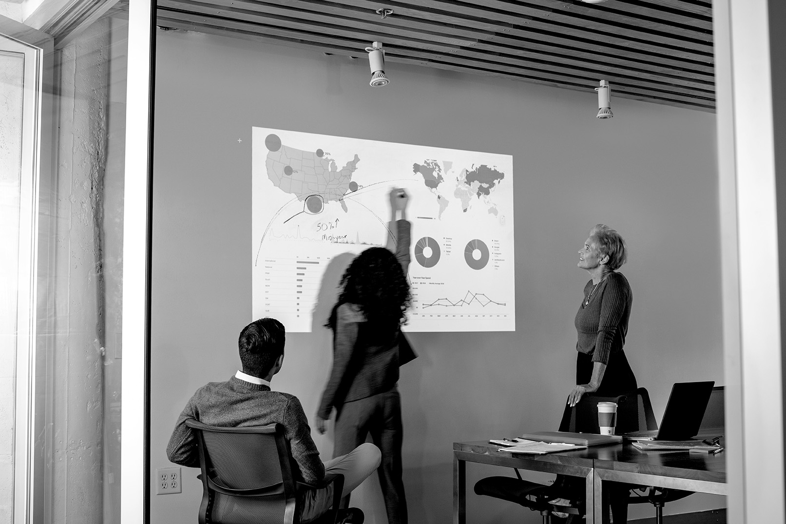
OVERVIEW
Structured process to understand what happened in an incident and id opportunities for improvement
Incident Analysis
KEY COMPONENTS
Timeline
What happened?
How can we detect sooner?
How can we recover sooner?
What went well?
Understanding system behavior
Blameless culture
Notes:
This started with incident analysis. Most of you are probably familiar, but just a quick review of incident analysis – it’s a structured process to understand what happened in an incident and find opportunities for improvement
Some key components include examining the timeline, asking a series of questions - what happened, how can we detect sooner, how can recover sooner, what went well – and understanding system behavior. Underpinning all of this is a blameless culture

Slide 9


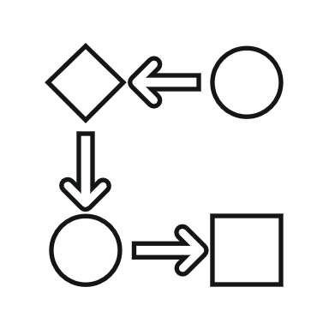
Growing from failure
Engaged with Adaptive Capacity Labs to analyze incident
Two weeks of intense interviews, research
More thorough understanding of events, different perspectives
Complex system failure
Understanding of incident response state
Series of recommendations of changes to implement
Notes:
So, we perform incident analysis on all of our major incidents. I always tell my people not to let an incident go by wasted. We have to learn something from it or it was all for nothing. With this outage, we wanted to take things a step further than our normal processes, so we brought in help.
We engaged with Adaptive Capacity Labs with Dr Richard Cook and John Allspaw to analyze our incident
Didn’t know what to expect, but great process of interviewing and dissecting all the different pieces
As someone who was on the front lines of this issue for pretty much the entire duration, ACL was able to uncover many things I didn’t see. It was eye-opening to me that such a methodical, detailed process could yield so much more understanding if you invested the time and dug deep enough
For me personally, I learned so much just from getting to be an observer in this process.
I learned so much more about complex system failure. We hold a monthly DevOps Culture Series talk and Richard spoke to us about complex system failure. I got to see more about that chaos of an complex system failure incident, learning that all perspectives are not the same
We likely won’t change perceptions of this incident, but we can affect future incidents
Stress doesn’t show a different culture, it reveals it – learned we had work to do
Out of all this, we got a better understanding of our overall incident response state.
We also get a series of recommendations of changes to implement, which would inform the next steps we took

Slide 10
Operational improvements
Operational Improvements program targeted the following
Data center/ platform resiliency
Incident response
Application reliability
Tool reliability
Notes:
After getting the improvement recommendations from ACL, we knew we needed to create a structure that would ensure proper prioritization and implementation.
We engaged our project management team to create such a program.
Through this program, we identified which recommendations we would like to move forward with. Specifically, application reliability, tool reliability, data center/platform resiliency, and incident response. Detailed tracks were organized for each focus area

Slide 11
Operational improvements
Operational Improvements program targeted the following
Data center/ platform resiliency
Incident response
Application reliability
Tool reliability
Overview of IMS
Rollout at CSG
Impacts for CSG
Notes:
We didn’t know it at the time, but the incident response changes we would make would lead to the most impactful changes at CSG.
I want to walk you through an overview of the system we implemented, how we rolled this out, and the impacts it has made for us
8:27

Slide 12

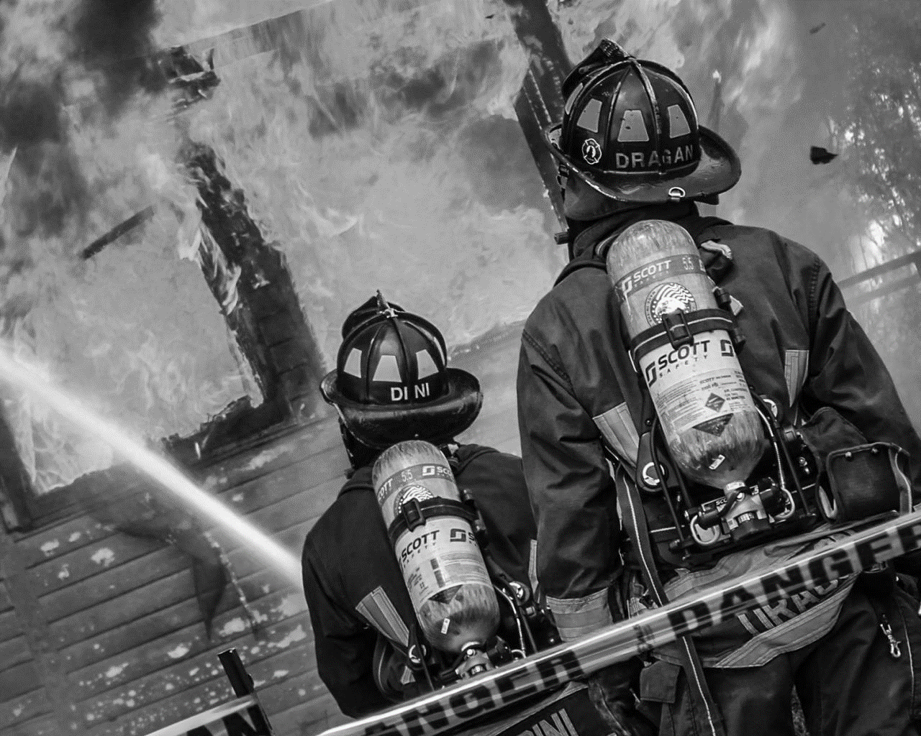
OVERVIEW
National standard for managing all hazard/risk incidents in the US for the last 40 years
Incident management system (IMS)
KEY COMPONENTS
Clear established roles
Incident commander, Scribe, LNO, SMEs
Communication cadence, format
Set of expected behaviors for participants
Common terminology
Management by objective
Notes:
So, let’s talk about the incident management system. This is a national standard for managing all hazard/risk incidents for the last 40 years. Talk about high pressure situations under chaos – things like forest fires, terrorist attacks, etc.
I’m not going to go into extreme detail about IMS. There is good documentation available for free and people like Brent Chapman have presented this at DOES before. I do want to give you a high level overview so you have some context.
First, there are a set of clear, established roles. It does not matter what your title is during peace time, the wartime roles are standard and require compliance.
The first key role is the incident commander, who is in the boss over the entire outage. They ensure IMS is followed, they direct traffic, and all decisions most go through them.
Other roles include the scribe, who does the note talking, the LNO (liaison officer), who helps provide updates to key stakeholders, and SMEs.
The second key component is a communication cadence where you provide regular updates in a consistent format. This provides stakeholders the information they need on a regular basis so the call is not distracted with status questions. It also ensures that those joining the call can get up-to-date without interrupting call cadence either
Third, there is a set of expected behaviors for participants.
There is a set of common terminology. For instance, “stand by” from the incident commander is a polite way to tell someone they do not have the floor
Finally, the entire purpose of the call is to resolve the issue. Any talk of causal factors or other needs are tabled until a later time

Slide 13
Incident command rollout
Trained 130 people as incident commanders
Engaged with Blackrock 3
Held two-week checkpoints with ICs
Piloted with group of 14 ICs
Updated whiteboard tooling
Trained organization in incident command
Extended to more
ICs
Notes:
HALFWAY AT END OF THIS SLIDE
In order to rollout IMS and incident command at CSG, we reached out to yet another group of expects – Rob, Chris, Ron at Blackrock 3.
I had personally researched quite a bit about running outage calls after our 2/4 outage. I had even read about IMS and companies like Pager Duty that were implementing this. However, this was a pretty disruptive change and we didn’t make headway until we went all-in and brought on training for our leaders.
Engaging with BR3 was a pivotal move in our IC rollout. They came into CSG, interviewed key people, and provided IC training.
We put 130 people through the incident commander training – people from many groups across CSG including those who would actually serve as ICs from the technical org, senior technical leaders, junior and senior members of our customer organization, and even some of our customers themselves. I heard many senior leaders say it was some of the best and practical training of their career
After the training was completed, we kicked off a pilot with 14 ICs. There was a lot of discussion about the pilot group size and it was a controversial decision.
We wanted to start small so we could gain experience, collect lessons learned and iterate before rolling out to a larger group. Now having the benefit of experience, I highly recommend that approach.
We put together an on-call rotation with two ICs covering each week for a total of 14 weeks.
We selected participants based on those that were already skilled at running outage calls. They will be strong change agents and already have a grasp of some of the nuances of outages, as well as the benefits this new framework provides
The reason this decision was controversial was that this group was a set of senior leaders that already have full plates. We don’t have dedicated ICs and we were worried about the toll on the group. It ended up being a non-issue as I’ll get into in a bit
Once we had the initial training in place, our group of 14 ICs identified for the pilot, we were off and running. We made other changes to support this framework as well
Shortly after kicking off our pilot, we trained our entire organization with an abbreviated version of the IC training. This training went to1600 people
With our pilot group and other key leaders, we held two-week checkpoints to discuss what was working and what was not. Training is one thing – doing if for real with company-specific culture is another. Sometimes the ICs simply shared how it was going and what they’d learned with others. We made changes such as cleaning up paging. We discussed things like the frequency of status updates – we like every 30 minutes - and how/when to vary from that cadence – this should be rare as people come to expect it. When deviating, the status update should indicate when the next update is coming. We decided that the IC would own the status report and the ISD team members would be responsible for sending it out to stakeholders
We had always kept a running whiteboard during outage calls, but the IC training pointed out some deficiencies in our previous tooling. Our International Service Desk (ISD) team fulfills the scribe roll on calls. They developed some tooling via Excel that improved our whiteboarding ability, showed all the previous status reports, identified who was filling what role on the call, and tracked follow up check-in times.
After our 14-week pilot, we’ve now extended the size of the IC pool

Slide 14
IC Improvements seen immediately
Observable difference in how an outage call is run
Clutter removed
Sense of control over chaos
Better behavior from call participants reduces noise
Singular focus is on resolving the outage
Status reports/LNO avoid interruptions for status
Predictable cadence and pattern are followed
Activities can run in parallel
Decision-making process is clear
Clear authority is established
Notes:
Once we rolled out incident command, improvements were seen fairly immediately. When I IC’d calls, I would get members of my team pinging me afterwards – people who had not even been trained yet in what IC was – telling me that the calls were so much smoother
When I took the training, I could see this would help, but it wasn’t clear how much until we put it into practice.
On a typical outage call for us, there were always a million things going on, on top of each other. IC removes a lot of that clutter.
People respect the new behavior expectations. Even if they had not been trained, they can “feel” how they are supposed to behave and this kept everyone from talking all the time
The calls started having a singular focus on resolving the outage – anything not related was tabled for later
Status reports and an LNO to provide more detailed status to customers eliminated the distractions on the call of constant discussion on status. They also help satisfy customer’ concerns that the outage is being effectively managed
After I had been trained in IC but before we had officially rolled it out, I sat on a call where a senior leader joined and proceeded to ask questions for 30 minutes or so. Questions like “Have you tried this?” and “what happens if we do this?” These are questions that it’s perfectly understandable someone would want to have answered. However, the call was about to discover the actual issue and these questions derailed the troubleshooting for the better part of an hour. The new framework 1) helps give answers to these questions without interruptions and 2) keeps the call focused on moving forward
IC also gave us a sense of control over chaos. We had a history of having people who “know everything” run calls – I was one of those people. We never followed the same pattern twice and you were making it up as you went in the middle of a crisis. Now, there was a pattern to follow.
Activities can run in parallel because actions are assigned out with ETAs on when they will check back in
Decision making is clear, which allows moves things along
Clear authority is established and maintained at all times. This helps prevent people from talking over each other and runs all things through one person
Provides sense of predictability
Overall, greatly reduces MTTR
Likely would have reduced the duration of 2/4 by several hours

Slide 15
“The Blackrock 3 Incident Management System enabled CSG to reduce customer downtime by 30% last year. This framework outlines critical roles, rules of engagement, and means of communication. This framework enabled us to work cooperatively to quickly resolve incidents when every minute matters.”
-KEN KENNEDY, PRESIDENT, TECHNOLOGY AND PRODUCT
thoughts from senior leaders
“Two of my favorite benefits of Incident Commander training are that everyone now understands their role during an incident and the flow of communications across the company and to our customers is so much better. The first 20 minutes of an incident call used to be spent just figuring out who was in charge and no one organized customer communications until it was a crisis. Now troubleshooting is orchestrated so much better and the result is shorter time to resolution following the Incident Commander processes.”
-DORAN STIENIKE, CIO
Notes:
I asked several of our senior leaders at CSG to provide their thoughts on IC and have included their exact thoughts here.
8:44

Slide 16
Lessons learned
IMS framework
Assumptions challenged
Almost all elements of the IMS framework held true
“Any prolonged issue of significance can be run by any IC” proven invalid
Pulling together
MTTA
Everyone pulls together and does what’s needed in times of crisis
Greatest opportunity to reduce MTTR with IC with domain expertise
first IC
Staffing on-call ICs
Prep yourself: it’s different. It gets much easier
If you’re involved, be involved in IC duties
Spelling it out
pool of senior ICs
Good people will figure things out
Needed to handle atypical scenarios
16
Notes:
23:30
We’ve learned a lot along the way of our IC journey and I hope some of our learnings can help with your own IC rollout.
As I previously stated, I think it would be pretty difficult to roll this out all on your own. Bringing in experts will provide a streamlined experience that will allow you to jumpstart changes. I’m not saying it can’t be done without help, but I strongly recommend bringing in experts
As we put training into practice, a number of things came to light for us
First, most elements of the IMS framework and training held true for us
Second, there was an extraordinary amount of pulling together and teamwork during a crisis. For the 14 Ics selected for the pilot, we worried about WLB. These people were already on call for their own products – now they would spend entire weeks where they were expected to respond and IC any outage within 10 minutes or so. It was a blessing and a curse to get selected. Congrats, you’re good enough at this that we want you to be on call more! We thought this was a sacrifice we needed to make, but we were worried how it would go. In reality, most outage calls had several other pilot Ics on the call in addition to the one actually running the call. People wanted to learn from each other and also wanted to pitch in on longer outages to relieve Ics who had been at it too long. We defined a time limit of 4 hours per IC
As far as the first time you IC, it different and a bit uncomfortable, but it quickly gets much easier
We wondered how much we would have to spell out in terms of exactly how things would go. What we found is that good people figure it out. Define the high-level framework, but you don’t need to define every single detail. Because we typically continue to have multiple qualified Ics on a call, they can work on the background to support anything the main IC needs
As far as assumptions challenged, for CSG, we do not have people whose sole job is IC. The IMS framework says that any prolonged issue of significance can be run by any IC.” We aren’t there yet. We’ve had the most luck with Ics who are familiar with the domain space. We want to revisit this one in a year to see if more experience changes this for us.
Going hand in hand with that, the training focused on MTTA. We’ve found that there is the greatest opportunity to improve MTTR is getting the right IC – and not just getting anyone fast
We are about nine months into our journey and recognize that we might get better at this and it might change, but that’s where we stand today. As an IC, I believe confidence plays a big part in successfully running a call and being assertive. I have much less confidence in areas where I don’t know the domain or the people.
Because of our learnings with regards to getting the right IC on the call, we went away from a specific on-call schedule and went to a model of “if you’re involved, be involved in IC duties.”
We had discussed “If you break it, you ic it.” We felt this reflected blame and wanted something that better reflected our blameless culture.
With his new approach, if we have large outages, qualified Ics are already getting paged as part of our triage process that existed before IC rollout. One of them needs to step up and run the call.
We’ve also found that as calls get bigger, Ics lower in the organization (think first or second line managers) eventually need to pitch in and help their teams from a SME/tech standpoint. This has been solved pretty naturally by them self-identifying that they need a higher level IC on the call. Usually, that person is already there anyway. If not, they can ask for someone to be paged
Going away from an on-call schedule was a topic of great debate. Many worried it would take to long to get the right IC on the bridge. In reality, I don’t believe there’s been a single call where this is an issue. In fact, I think people are now more inclined to jump on a bridge they wouldn’t have otherwise to make sure there is an IC in place. You do need to ensure you have an adequate number of Ics trained in each product area
As we’ve expanded our pool of Ics considerably, we’ve recognized that there might been some atypical scenarios where our strongest, most senior Ics might need to pitch in. So, we came to a group agreement on about ten people that belong to our “senior IC pool”
Situations where we might need them include
No one on a bridge who is qualified to IC. We’ve set a time limit of 20 minutes – I don’t think we’ve had to escalate out of this
Current IC struggling to run a call
Widespread outage across many products
In practice, we luckily haven’t had to use this much in the couple of months since it has been set up

Slide 17
Operational improvements
Operational Improvements program targeted the following
Data center/ platform resiliency
Incident response
Application reliability
Tool reliability
Notes:
We didn’t know it at the time, but the incident response changes we would make would lead to the most impactful changes at CSG.
I want to walk you through an overview of the system we implemented, how we rolled this out, and the impacts it has made for us
8:27

Slide 18
Other changes since the outage
Reduced failure group size for load balancers
Operational Improvements
Leveraging group chat for incidents
Improving network monitoring
Making it safe to talk about failure
Continuing public cloud exploration & growth
Implementing out of band network
Notes:
We’ve engaged with a third party to define and implement improvements to network monitoring
For our load balancers, we have reduced the failure group size by virtualizing the infrastructure and breaking it up into more, smaller load balancers
We had a healthy start on public cloud initiatives. We now have an official program to continue this exploration and growth
Blackrock 3 emphasized how helpful chat vs verbal can be during an outage. While we haven’t implemented a formal system, many teams now leverage the power of Microsoft Teams to get some chatter off the call and into a persistent format that can be followed by anyone on that team
We’ve also made it safe to talk about failure. I think all of us feel a sense of los and sometimes embarrassment with failures, which leads us to want to sweep them under the rug when we are done. However, if we don’t talk about them, others can’t learn. We host a monthly DevOps Culture Series and we’ve had the topic of several of these be to simply talk about major outages/failures for CSG in the past
We are also working with a third party company to implement an OOB network

Slide 19
Other things we’ve learned about
COMPLEX SYSTEM FAILURE
AVOIDING FAILURE REQUIRES FAILURE
It’s everywhere!
Some things can’t be learned except by doing
COMMON REACTIONS TO FAILURE
WE CAN COME BACK FROM THIS
Stress, hindsight bias, blame, human error
Impact minutes goal still achieved
Notes:
As I look back over the time since our outage, I’ve personally learned so much and so has CSG.
We’ve talked about incident analysis, incident command, and other ways to make our system safer. I want to touch on a few other things we’ve learned
We now see complex system failure in many aspects of life.
For instance, my peers, my boss and I discussed the Chernobyl miniseries and how that is an example of complex system failure.
We think we are unique in software, but complex system failure looks the same in every industry. We thought our outage was unique even within software. We learned we are unique….just like everyone else.
If you haven’t read Dr Richard Cook’s paper on this, google “how complex systems fail” – it’s a great read.
Our failure fell right in line here – multiple failures occurred, latent flaws, always changing flaws. The more complex our systems become, the more glorious are the ways in which we can fail.
Common reactions to failure
STRESS
Hindsight bias
Blame
Desire to punish
Human error attributed 85% of the time. It’s our job to make systems that are safe for humans to operate in

Slide 20

Recap, recommendations & help I’m looking for
Find the opportunity in failure
Engage with experts
Make post-incident analysis part of your culture
Implement Incident Command
Keep learning
Share your story!
How did you fail in grand fashion?
How have you implemented Incident Command?
Notes:
Nasty outage or tough time
Take own advice
Meet great people
When I reflect back on this, , when my people are going through a particularly tough time or nasty outage, that someday they’ll look back on this as a blessing – a great learning opportunity.
When I had to take my own advice on this, it wasn’t very fun. 2/4 is a day will stick with me for my entire career.
We’ve gotten to meet some great people on this journey who have helped impart wisdom, shape our path, and cause us to think differently. As a result of this, I’ve grown and so have my teams and the larger CSG.
I hope you can learn from this as well. I recommend you

Slide 21
Thank You!
Erica Morrison
Executive Director, Software Engineering
erica.morrison@csgi.com
@ericarmorrison

